Slide 1
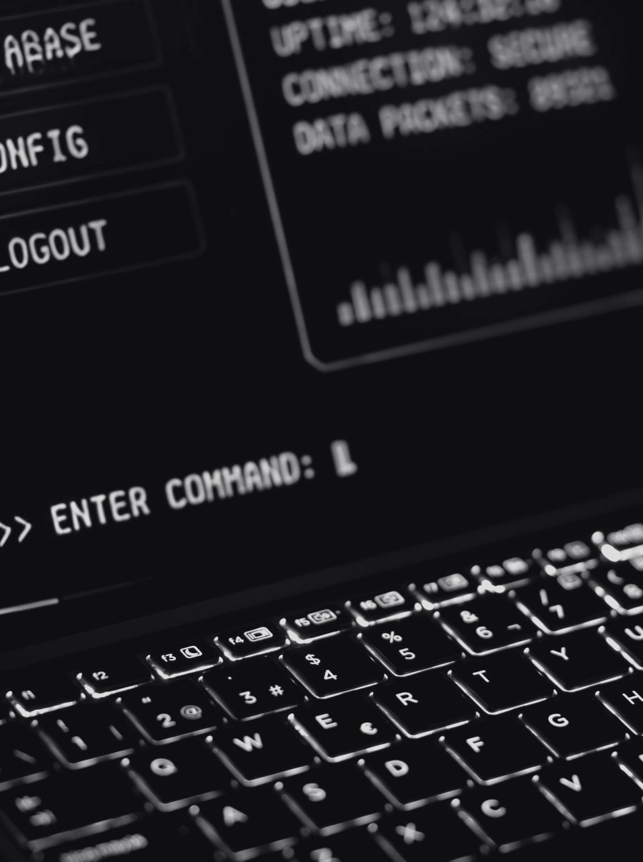

THE UNIVERSITY OF BAMENDA
College of Technology · Department of Computer Engineering
MASTER'S DISSERTATION DEFENCE
CYBERFORGE
A real-time agentic AI system for web threat detection and user protection
CHE HAGGAI NGHA KANG · UBA24PP134
Supervisor: Prof. Onabid Mathias Akong, Associate Professor
Master's in Computer Engineering — Information Technology and Cyber Security · June 2026
Notes:
Good morning. My dissertation is CyberForge, a real-time agentic AI system for web threat detection and user protection, supervised by Professor Onabid Mathias Akong. I will follow the structure: introduction, problem, research questions and objectives, a brief literature review, methods and materials, results, and the conclusion.

Slide 2

01 · BRIEF INTRODUCTION
01 / 08
BRIEF INTRODUCTION
Why web-threat detection needs more than one model
01
THE BROWSER IS THE ATTACK SURFACE
Phishing, drive-by downloads, credential theft and malicious ads, as the boundary moved from firewall to browser (Provos et al., 2007; Khonji et al., 2013).
02
SIGNATURES FALL BEHIND
Fast-changing domains, hidden payloads and short-lived infrastructure defeat signature-based tools.
THE PRESENT STUDY
03
DETECTION GREW SMARTER
Machine learning, then deep learning and Transformers that read URLs in context (Devlin et al., 2019).
CYBERFORGE
A multi-platform, agent-based system that analyses URLs in real time and protects users while they browse. Specialised agents classify the URL, analyse the domain, inspect behaviour, look up threat intelligence and map attacker techniques, then agree one verdict.
04
FROM ONE MODEL TO AGENTS
Specialised agents for detection, extraction, analysis and reporting, reasoning step by step like analysts (Yao et al., 2023).
Thesis §1.1 Background of the Study
02
Notes:
The web is now the main attack surface. Signature tools fall behind fast-changing domains, so research moved to machine learning, deep learning and Transformers, and now to systems of specialised agents. CyberForge is my response: specialised agents analyse each URL in real time and agree one explained verdict. Scope is URL and web-context security; kernel, firmware and enterprise lateral movement are out of scope (§1.6).

Slide 3

02 · PROBLEM STATEMENT
02 / 08
PROBLEM STATEMENT
Three persistent problems limit AI threat detection for ordinary users and small teams
01
02
03
TOO MANY FALSE ALARMS
A NUMBER, NOT A STORY
NO OPEN, CONNECTED SYSTEM
Single-model URL classifiers are prone to false positives. An early CyberForge heuristic rated every URL, google.com included, "medium risk" because of a +0.5 offset. Alert fatigue makes users ignore real threats.
A classifier gives a probability, but cannot list the indicators of compromise on the page, map script activity to a MITRE technique, or link the domain to earlier threat reports.
No widely deployed open system fans one browser event out to specialised analysers, keeps the result, reuses past visits and shows it on desktop and mobile. SOAR does, at enterprise cost.
CyberForge answers with specialist analysis, inspectable evidence and controlled sharing of results
Thesis §1.2 Problem Statement
03
Notes:
Three problems. First, false alarms: my own early heuristic returned 'medium' for every URL because of a +0.5 baseline offset, which shows how biases stay hidden until deployment. Second, explainability: a probability is not a story an analyst can act on. Third, no open architecture combines specialised analysers, memory and cross-device display; SOAR products do, but at enterprise scale.

Slide 4

03 · RESEARCH QUESTIONS
03 / 08
RESEARCH QUESTIONS
GENERAL QUESTION
How can a multi-agent AI system, organised as a network of specialised analysers, be designed to provide real-time and explainable threat intelligence and protection for URLs and web resources across different platforms?
RQ1
DECOMPOSITION
How can URL analysis be divided among different AI agents, and what is the smallest set of agents needed for a reliable threat assessment?
RQ2
INTEGRATION
How can URL classification, behavioural analysis, IOC extraction, MITRE ATT&CK mapping and threat-intelligence lookup be combined into one consistent, accurate system?
RQ3
AGGREGATION
What method can combine the agents' results to reduce false alarms while still identifying serious threats when strong evidence is available?
RQ4
HISTORICAL CONTEXT
How can historical browsing information improve detection, identify recurring malicious activity and strengthen protection over time?
Thesis §1.3 Research Questions
04
Notes:
The general question asks how a network of specialised analysers can give real-time, explainable protection across platforms. It breaks into four: decomposition, integration of the analysis types, aggregation that reduces false alarms without hiding strong threats, and the use of historical browsing context.

Slide 5
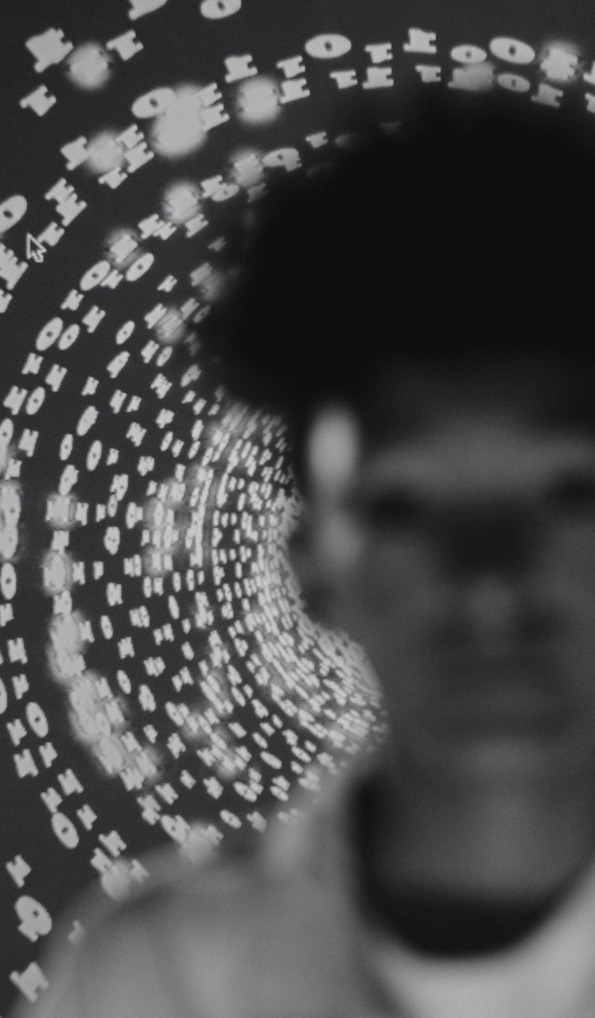
04 · RESEARCH OBJECTIVES
04 / 08
RESEARCH OBJECTIVES
GENERAL OBJECTIVE
Design, implement and evaluate a multi-platform AI-driven system that monitors URLs in real time, detects and explains threats with cooperating agents, and gives timely alerts and protective feedback while keeping historical context and threat records.
OBJECTIVE 1 → RQ1
OBJECTIVE 2 → RQ2
MULTI-AGENT FRAMEWORK
UNIFIED DETECTION
Decompose URL analysis into coordinated tasks for reliable real-time assessments.
Combine content, behaviour, structure and threat intelligence for accuracy and consistency.
OBJECTIVE 3 → RQ3
OBJECTIVE 4 → RQ4
DECISION AGGREGATION
CONTEXTUAL INTELLIGENCE
Cut false alerts while strong malicious indicators still trigger immediate warnings.
Link current URL behaviour with known attack patterns and external threat databases.
Thesis §1.4 Objectives of the Study
05
Notes:
The general objective is to design, implement and evaluate the system end to end. Each specific objective answers one research question: the agent framework, the unified detection approach, the aggregation that controls false alerts, and contextual threat intelligence.

Slide 6

05 · BRIEF LITERATURE REVIEW · 1 OF 2
05 / 08
BRIEF LITERATURE REVIEW
From rules to learning to cooperating agents
RULES & FEATURES
CLASSICAL ML
DEEP LEARNING
HYBRID + AGENTS
Mohammad et al., 2014
Sahingoz et al., 2019
Le et al., 2018; Devlin et al., 2019
Khonji et al., 2013; Yao et al., 2023
2007
2010
2012
2013
2016
2018
2018
2019
2023
2023
PROVOS ET AL.
SOMMER & PAXSON
ANTONAKAKIS ET AL.
KHONJI ET AL.
LIAO ET AL.
STROM ET AL.
LE ET AL.
DEVLIN ET AL.
YAO ET AL.
PARK ET AL.
Drive-by downloads on 1.3% of sampled pages; predicted short-lived domains and polymorphic scripts.
ML for intrusion detection must handle costly errors and be interpretable.
DGA domains look random: high entropy, few vowels, digit mixing.
Survey of 70+ phishing works: combine lexical, content and reputation features.
Automatic IOC discovery from open threat reports; STIX/TAXII sharing.
MITRE ATT&CK: a shared language for attacker tactics and techniques.
URLNet learns URL representations directly from raw text.
BERT: pre-train, then fine-tune; security-adapted variants followed.
ReAct: reason, act, observe, repeat — the loop behind agents.
Generative Agents: memory keeps agents consistent over time.
Thesis Chapter 2 (§2.2–2.9); full references on the final slide
06
Notes:
The literature moves through four stages: hand-written rules, classical machine learning, deep learning and Transformers, and now hybrid designs and agents. The timeline scrolls through the works the design builds on: Provos on drive-by downloads, Sommer and Paxson's critique, Antonakakis on DGAs, Khonji's phishing survey, IOC extraction, MITRE ATT&CK, URLNet, BERT, ReAct and Generative Agents.

Slide 7

05 · BRIEF LITERATURE REVIEW · 2 OF 2
05 / 08
RESEARCH GAPS
Five gaps between research ideas and working systems
G1
FEW COMPLETE MULTI-AGENT SECURITY SYSTEMS
Frameworks show the idea; few open systems apply it end to end.
A full working pipeline of connected agents
G2
MODEL AND SERVICE FAILURE
Systems rarely say when a model or service did not answer.
Capability readiness, explicit unknown states
G3
ACCURACY OVER REAL FALSE ALARMS
Lab scores hide how often safe sites are flagged (Sommer & Paxson, 2010).
Multi-signal aggregation for few false alarms
G4
HISTORICAL CONTEXT UNUSED
Past observations are rarely reused later (Park et al., 2023).
Memory supplies prior verdicts as context
G5
HARD TO REPRODUCE
Private data, closed systems, costly infrastructure.
Public tools and modular, testable services
Thesis §2.10 Research Gaps
07
Notes:
Five gaps motivate the work: few complete multi-agent security systems, little honesty about model and service failure, a focus on accuracy rather than false alarms, unused historical context, and poor reproducibility. Each lime answer shows how CyberForge responds.

Slide 8

06 · METHODS AND MATERIALS USED · 1 OF 6
06 / 08
SYSTEM ARCHITECTURE
Four layers with a clear data flow
CLIENT
Tauri 2 desktop · React Native/Expo companion · scoped Rust CLI · grant-controlled MCP tools
ADDRESS
manual, or a consented observation
NATIVE & BACKEND CONTROL
Shared Rust services, OS keyring, local ownership · Node.js 24/Express: authentication, workspaces, device and agent workflows
PRIVACY & SESSION CHECKS
in the native layer
INFERENCE
FastAPI on Hugging Face Spaces: trained URL models, BERT, DGA rules, Qwen explanations, versioned contracts
BACKEND ROUTES
pick the analysis service
PERSISTENCE & INTELLIGENCE
MongoDB records, selected Appwrite integrations, local stores and caches · AlienVault OTX, page fetching
LABELLED RESULT
with coverage and failures
Thesis §3.2 System Architecture, Figure 3.1
08
Notes:
The architecture separates four layers: clients, native and backend control, inference, and persistence with intelligence. A request passes privacy and session checks in the native layer, the backend selects the service, and the user receives a source-labelled result that states its coverage and any failure.

Slide 9
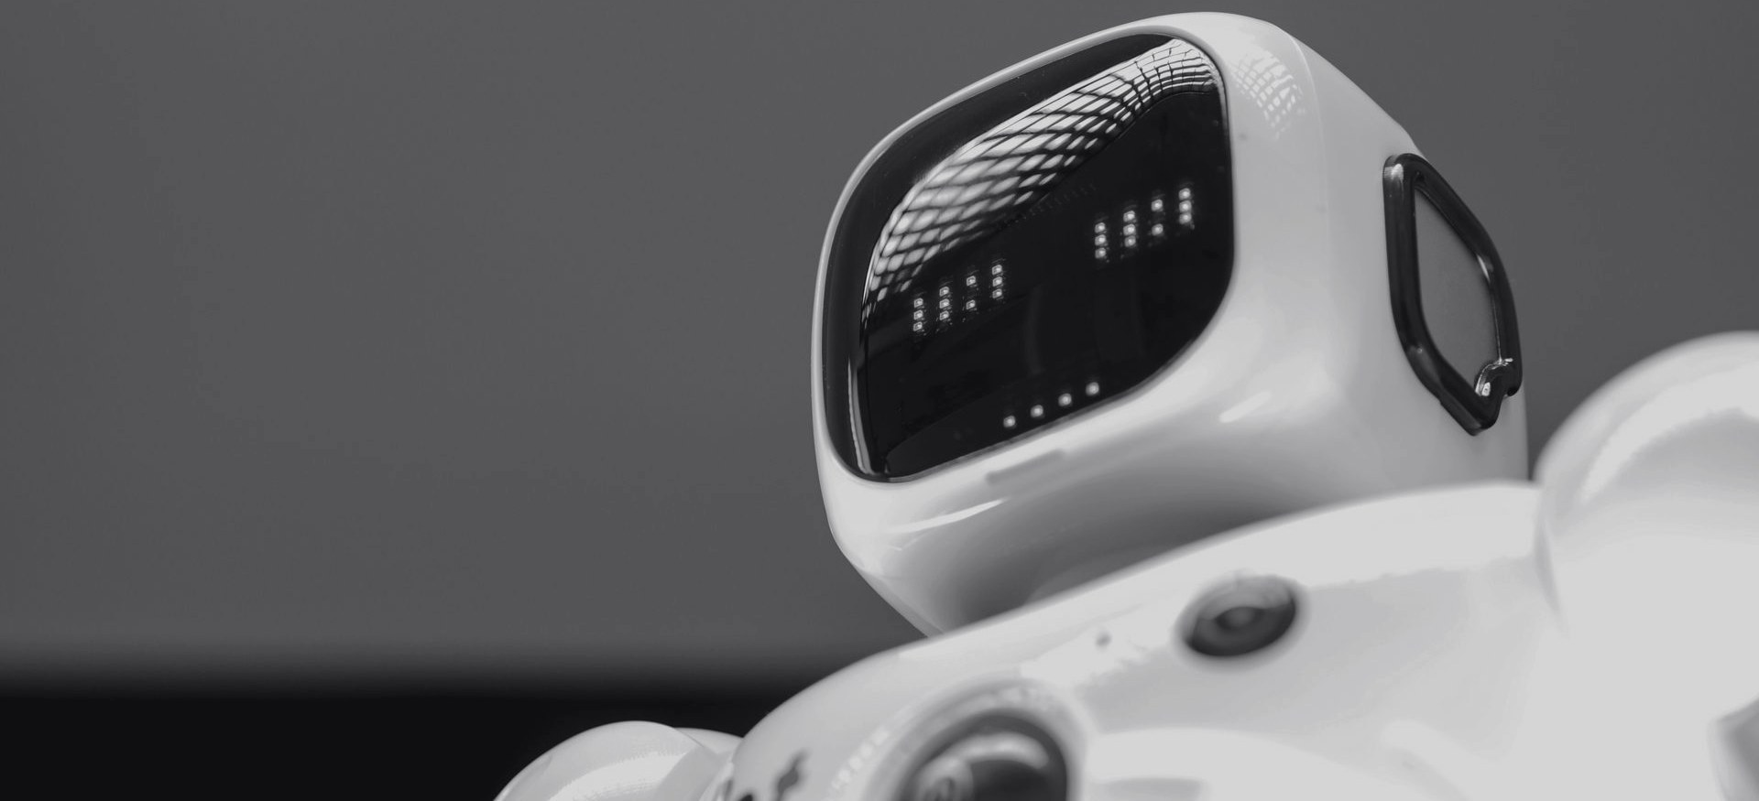
06 · METHODS AND MATERIALS USED · 2 OF 6
06 / 08
EIGHT-AGENT PIPELINE
A three-stage directed acyclic graph, then a Reporter
STAGE 1
URL & context, in parallel
STAGE 2
once the page is scraped
STAGE 3
needs the extracted IOCs
REPORTER
combines every result
URL CLASSIFIER
BERT label + confidence
IOC EXTRACTOR
10 patterns: IPs, URLs, hashes, CVEs
THREAT INTELLIGENCE
AlienVault OTX reputation
REPORTER AGENT
risk score, verdict, explanation, stored report
DGA DETECTOR
entropy, character patterns
BEHAVIOURAL ANALYSER
eval/atob, hidden forms, trackers
WEB SCRAPER
content, scripts, headers
MITRE MAPPER
20 signals → ATT&CK
MEMORY READER
past visits and verdicts
Historical blend (Eq. 3.1) risk = 0.6 × mean agent score + 0.4 × maximum agent score — one strong signal still raises the verdict
Thesis §3.8, Table 3.1; historical blend Eq. 3.1
09
Notes:
Eight specialist agents run in three stages plus a Reporter. Stage one works on the URL alone, in parallel: the BERT URL classifier, the DGA detector, the web scraper and the memory reader. Stage two needs the scraped page: IOC extraction with ten patterns, behavioural analysis, and MITRE mapping with twenty signals. Stage three enriches IOCs from AlienVault OTX. The Reporter combines everything; the original blend weights the mean at 60% and the strongest signal at 40%, so one strong signal is not averaged away. The current ReportAgent uses a weighted evidence sum instead (§3.4).

Slide 10

06 · METHODS AND MATERIALS USED · 3 OF 6
06 / 08
MATERIALS
Software, libraries, services, data and hardware
SOFTWARE
KEY LIBRARIES
TAURI 2 / RUST DESKTOP
TRANSFORMERS 4.40+
Node.js 24 + Express 4 backend · Python FastAPI on Hugging Face Spaces · React Native / Expo companion · Rust core, CLI and MCP
scikit-learn 1.8.0 · torch 2.2+ · llama-cpp-python 0.3.36 · huggingface_hub · pandas, NumPy · axios · node-appwrite
SERVICES
DATA & MODELS
HUGGING FACE SPACES
BERT MALWARE-URL-DETECT
MongoDB/Mongoose · Appwrite · AlienVault OTX · WebScrapper.live · Qwen3.5-2B GGUF via llama.cpp
Qwen3.5-2B GGUF · MITRE ATT&CK v15 · OTX pulses · public phishing, malware-URL, Tranco top-1M and web-attack corpora
Hardware Original development: Apple-silicon MacBook, 16 GB RAM, macOS Sonoma 14.6
Thesis §3.6 Materials; Appendix C.3
10
Notes:
The materials: a Tauri 2 and Rust desktop, a Node.js 24 Express backend, a Python FastAPI service on Hugging Face Spaces, a React Native companion, and a shared Rust core with a CLI and MCP adapter. Pretrained BERT and Qwen are used for inference only; the training data are public phishing, malware-URL, popularity and web-attack corpora.

Slide 11

06 · METHODS AND MATERIALS USED · 4 OF 6
06 / 08
DEVELOPMENT & CALIBRATION
Seven deployable iterations, then calibration
1
2
3
4
5
6
7
FOUNDATION
SINGLE CLASSIFIER
FALSE-POSITIVE FIX
SANDBOX
TRANSFORMERS
AGENTIC DAG
UI INTEGRATION
repos, Heroku and Space, Appwrite, ML stub
scraper → classifier → Gemini → alert
+0.5 offset removed; model consensus
IOC extractor, MITRE mapper, evidence locker
BERT URL classifier, entropy DGA
eight agents, memory, LLM fallback
desktop polling, agent grid, dashboard
CALIBRATION 1
CALIBRATION 2
CALIBRATION 3
RISK-SCORE CALIBRATION
DGA HEURISTIC CALIBRATION
LLM FALLBACK VERIFICATION
7 researcher-labelled URLs, from google.com to paypa1-secure-login.tk; the +0.5 offset removed and thresholds adjusted. A development check, not held-out evidence.
30 legitimate and generated-looking domains; empirical threshold 0.45 on entropy and character patterns.
Gemini exhaustion → Mistral fallback → rule-based response, each exercised in the prototype.
Thesis §3.7 Methodology; Appendix A
11
Notes:
Development was iterative: seven deployable iterations, each checked with representative URLs. Iteration three found the +0.5 baseline offset behind the 'medium risk for everything' defect. Calibration used seven labelled URLs for the risk score and thirty domains for the DGA threshold of 0.45; the explanation fallback was exercised from Gemini through Mistral to rules. These are development checks, separate from the evaluation set.

Slide 12
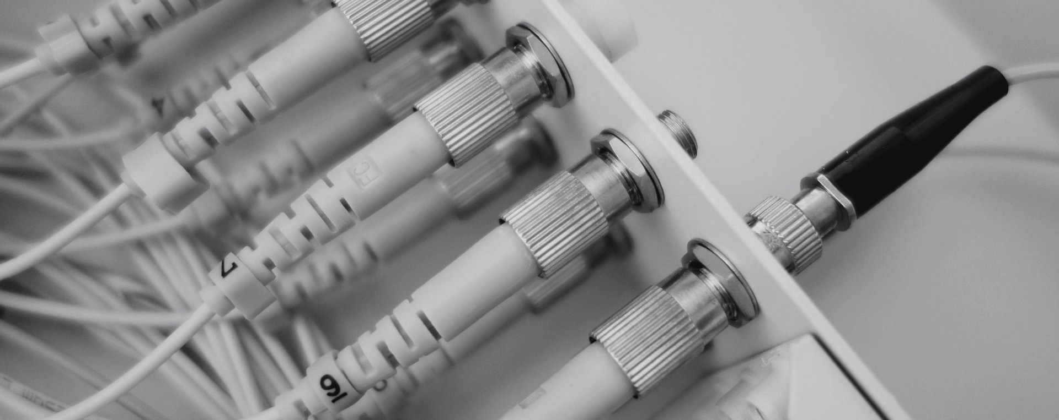
06 · METHODS AND MATERIALS USED · 5 OF 6
06 / 08
LEARNING & TRAINING
Four kinds of learning, five training phases
SUPERVISED
UNSUPERVISED
PRETRAINED
RULES & RETRIEVAL
THREE GRADIENT-BOOSTED CLASSIFIERS
ANOMALY DETECTION
BERT AND QWEN
HEURISTICS AND MEMORY
IsolationForest on benign URL features: 200 trees, contamination 0.02. Anomaly is not proof of harm.
External BERT URL classifier; Qwen3.5-2B explanations through llama.cpp. Used, not fine-tuned.
Entropy DGA rules, regex IOC extraction, memory as context. No online weight updates.
Phishing, malware-serving URLs and web-attack payloads (SQLi/XSS), with scikit-learn.
1
2
3
4
5
COLLECT & CLEAN
FEATURES & SPLIT
FIT
THRESHOLDS
PUBLISH
public corpora, normalise, de-duplicate
shared features; domain-grouped 20% test, 10% thresholds
≤300 iterations, learning rate 0.1, 31 leaves, seed 42
at a 2% false-positive target, then held-out check
only accepted models, with their metadata
Thesis Appendix C.3–C.4; §2.3.3
12
Notes:
Four kinds of learning are kept apart: supervised gradient-boosted classifiers (HistGradientBoostingClassifier), an unsupervised IsolationForest on benign URLs, pretrained BERT and Qwen used only for inference, and rules with memory retrieval. Training follows five phases, with domain-grouped splits so the same domain never sits in both training and test, and thresholds chosen for a 2% false-positive target.

Slide 13
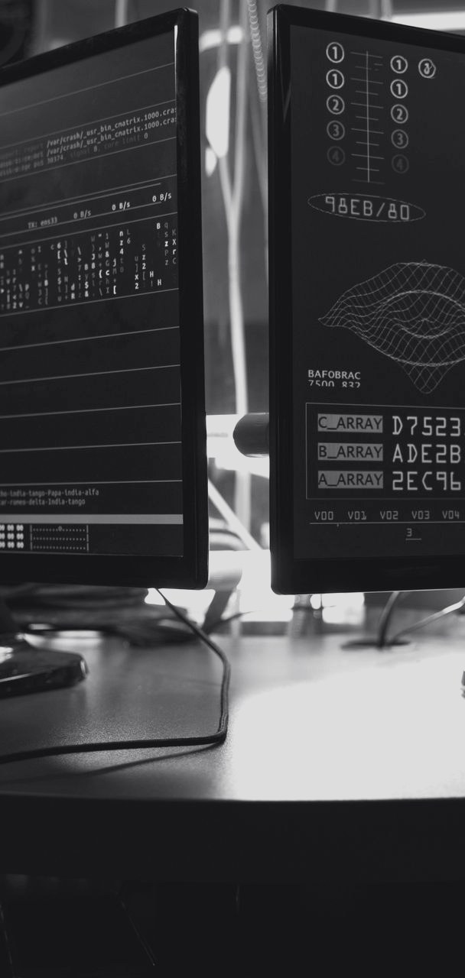
06 · METHODS AND MATERIALS USED · 6 OF 6
06 / 08
EVALUATION DESIGN
300 URLs and four criteria set before testing
300
FUNCTIONAL CORRECTNESS
Every agent returns its documented shape; the Reporter matches the expected verdicts.
URLS EVALUATED
FALSE-POSITIVE RATE
Common benign sites (google.com, github.com, wikipedia.org…) judged clean or low risk 100% of the time.
Benign websites
150
Phishing websites
TRUE-POSITIVE COVERAGE
100
Curated phishing URLs judged suspicious or malicious at least 80% of the time.
Malware / DGA domains
50
END-TO-END LATENCY
Positive class = the 150 harmful URLs
Mean over 100 requests: at most 10 s from a cold start, 4 s when warm.
Thesis §3.9 Evaluation Methodology; §4.3
13
Notes:
The evaluation set has 300 URLs: 150 benign, 100 phishing and 50 malware or DGA domains, with the harmful URLs as the positive class. Four criteria were set before testing: functional correctness, false positives on common benign sites, coverage of curated phishing, and latency of at most ten seconds cold and four seconds warm.

Slide 14
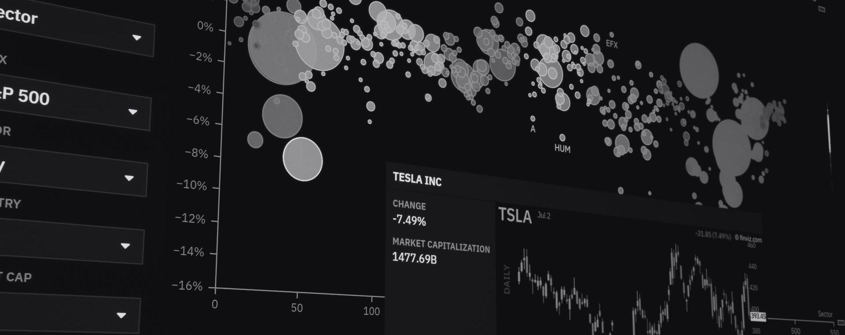
07 · RESULTS · 1 OF 4
07 / 08
DETECTION PERFORMANCE
300-URL evaluation of the prototype
94.7%
97.9%
91.3%
98.0%
94.5%
2.0%
ACCURACY
PRECISION
RECALL
SPECIFICITY
F1 SCORE
FP RATE
284 of 300 correct
alerts that were right
harmful sites caught
safe sites left alone
precision–recall balance
3 of 150 benign
CONFUSION MATRIX
DETECTION BY CATEGORY
137
13
Safe (benign) websites 147 / 150
Actual harmful
98.0%
True positives
False negatives
Phishing websites 92 / 100
92.0%
3
147
Actual benign
Malware and DGA domains 45 / 50
False positives
True negatives
90.0%
Thesis Tables 4.3 and 4.4 (historical prototype results)
14
Notes:
On the 300-URL set the prototype classified 284 correctly: 94.7% accuracy, 97.9% precision, 91.3% recall, 98% specificity and F1 94.5%. Only three of 150 benign sites were flagged, a 2% false-positive rate. Benign detection was 98%, phishing 92% and malware/DGA 90%. These are the historical prototype results; they were not re-run on the revised implementation.

Slide 15
07 · RESULTS · 2 OF 4
07 / 08
PROCESSING SPEED
Where the 4.05 seconds go
STAGE 1 · URL & CONTEXT
850 ms 21%
MEAN END TO END
4.05 s
STAGE 2 · CONTENT ANALYSIS
1,200 ms 30%
STAGE 3 · THREAT INTELLIGENCE
600 ms 15%
Warm target 4.00 s: missed by 0.05 s
Cached repeat visits: under 100 ms, about 15% of queries
REPORTER · REPORT GENERATION
1,400 ms 34%
SLOWEST AGENT IN EACH STAGE
720 ms
900 ms
600 ms
1,400 ms
URL CLASSIFIER
WEB SCRAPER
THREAT INTELLIGENCE
REPORTER
BERT, Stage 1
page acquisition
OTX lookups
scoring and explanation
Thesis Tables 4.1 and 4.2 (historical prototype results)
15
Notes:
The mean end-to-end analysis took 4.05 seconds, 50 milliseconds over the strict four-second warm target, so I report that objective as not met. The Reporter, with the language-model explanation, is the largest share at 34%. Cached repeat visits returned in under 100 milliseconds.

Slide 16
07 · RESULTS · 3 OF 4
07 / 08
RELIABILITY
How dependably each agent and service answered
AGENT RELIABILITY · USABLE RESULT, NOT A TIMEOUT OR ERROR
EXTERNAL SERVICES · UPTIME · FALLBACK
URL CLASSIFIER
99.5%
HEROKU BACKEND
99.9%
desktop retries
DGA DETECTOR
100%
HUGGING FACE SPACE
99.2%
cached or heuristic result
WEB SCRAPER
96%
MEMORY READER
100%
ALIENVAULT OTX
97.5%
scan continues unenriched
IOC EXTRACTOR
99%
GOOGLE GEMINI
98.0%
Mistral, then rules
BEHAVIOURAL ANALYSER
98.5%
MITRE MAPPER
99%
APPWRITE CLOUD
99.7%
kept locally, synced later
THREAT-INTEL ENRICHER
95%
REDIS CACHE
99.9%
full pipeline instead
REPORTER
99.8%
scale 90% → 100%
Thesis Tables 4.5 and 4.7 (historical test period; return-success and uptime, not accuracy)
16
Notes:
Reliability is how often each agent returned a usable result, not its accuracy. All agents were above 95%; the web scraper and the OTX enricher depend on outside services and were lowest. Every external service had a fallback, so a scan degrades instead of failing; these uptime figures are from the original test period.

Slide 17
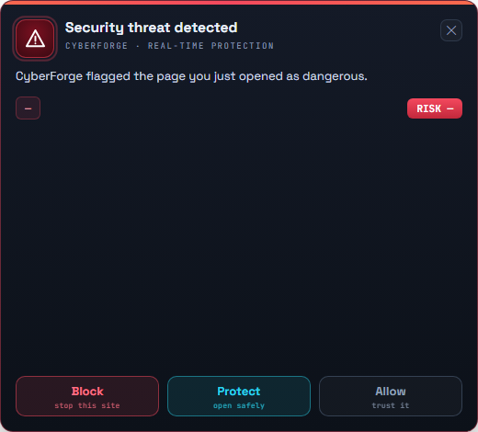
07 · RESULTS · 4 OF 4
07 / 08
EXPLANATIONS & OBJECTIVES
Explanation quality and every objective against its target
AI-WRITTEN EXPLANATIONS · MANUAL 1–10 RATINGS
OBJECTIVES MET · TABLE 4.8
FACTUAL ACCURACY
correct MITRE techniques and IOCs
9.5
REAL-TIME ANALYSIS
warm mean ≤ 4.00 s
4.05 s
NOT MET
READABILITY
a non-expert could follow it
9.0
94.7%
ACCURATE DETECTION
above 90% accuracy
MET
USEFULNESS OF ADVICE
clear next steps
8.8
FEW FALSE ALARMS
keep false alarms low
2.0%
MET
SPEED
Gemini ≈1.2 s, Mistral ≈2.0 s
8.5
CLEAR EXPLANATIONS
readable by non-experts
9.0 / 10
MET
The prototype's real-time alert, with Block, Protect and Allow. A historical interface illustration from the thesis.
RELIABLE INTEGRATIONS
stable cloud services
97.5%+
MET
Thesis Tables 4.6 and 4.8; Figure 4.3 (historical interface)
17
Notes:
Explanations were rated 9.5 for factual accuracy and 9.0 for readability by non-experts; these are descriptive manual ratings, not a blinded user study. Against the targets, four of five objectives were met. Real-time analysis was not: 4.05 seconds against a strict 4.00-second target.

Slide 18

08 · CONCLUSION
08 / 08
CONCLUSION
What the study shows, and what it does not
284/300
137
3
4.05 s
URLs classified correctly
harmful URLs detected
benign URLs falsely flagged
mean end-to-end analysis
01
02
03
CONTRIBUTION
WHAT IT DOES NOT PROVE
WHERE IT IS NOW
Eight specialist analyses and a Reporter combine complementary evidence into one inspectable, explained verdict, with few false alarms.
No single-model ablation: no proof of superiority to one model, universal protection or current production performance.
Verified identity and workspaces, five privacy choices, service authentication, device signing and explicit action states.
Thesis §5.1 Conclusion; §4.9
18
Notes:
To conclude: the integrated, explainable workflow classified 284 of 300 URLs correctly with only three false alarms, in a little over four seconds. The contribution is the integration of complementary evidence into one explained verdict. The limits are clear: there is no single-model ablation, and the historical results are not a measurement of the revised system. The current source adds the access, privacy and signing controls recommended after the prototype.

Slide 19

08 · CONCLUSION
08 / 08
RECOMMENDATIONS
And perspectives for future research
RECOMMENDATION 1
RECOMMENDATION 2
SECURITY ASSURANCE
PRIVACY & RETENTION
Test account switching, grant revocation, hostile input, replay, expiry and elevation prompts in the packaged product.
Validate the five consent categories, URL redaction, deletion and sync withdrawal across every client.
RECOMMENDATION 3
RECOMMENDATION 4
MODEL QUALITY
ACTION SCOPE
Temporal and domain-held-out evaluation; isolated training; reviewed feedback, never unchecked retraining.
Verified rollback before broader automatic response; grow CLI and MCP only with permission contracts.
PERSPECTIVES
Longer deployments with raw logs · agent ablations · independent regional and hosted-phishing corpora · a blinded explanation study · isolated training · richer CLI and MCP tools · packaged mobile capture · a real dynamic-execution sandbox
Thesis §5.2 Recommendations; §5.3 Perspectives
19
Notes:
Four recommendations follow: test the security controls in the packaged product, validate the privacy and retention controls across all clients, strengthen model evaluation and isolate training, and widen automatic actions only after verified rollback. Future research should include ablations, independent corpora and a blinded study of the explanations.

Slide 20
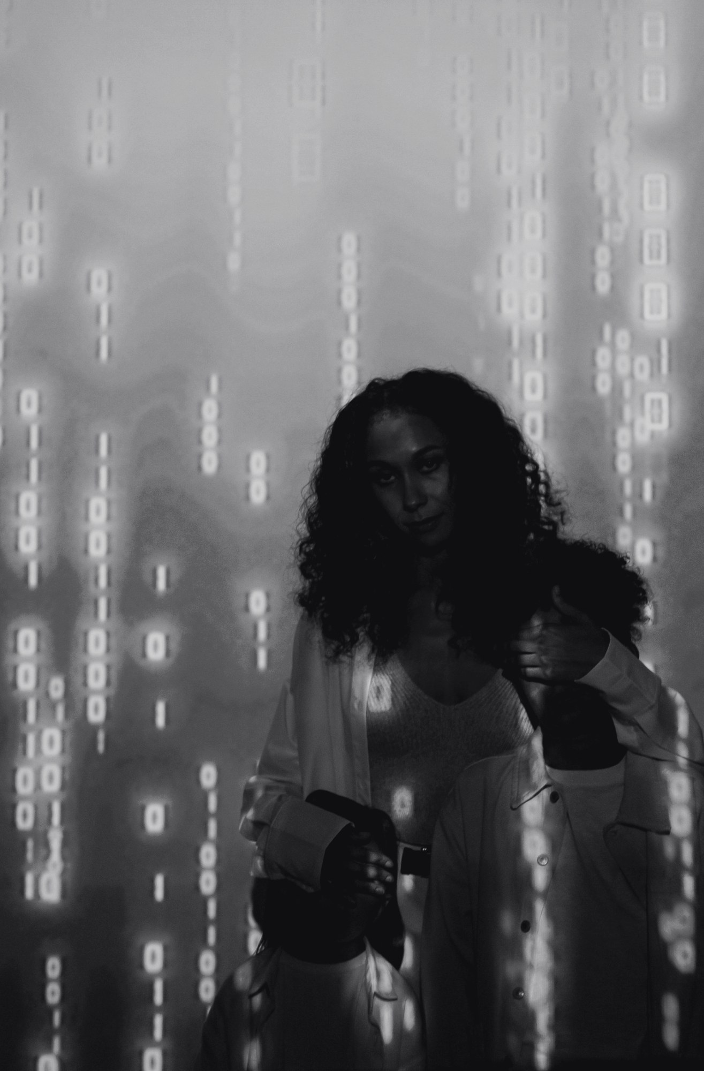
REFERENCES
Anderson & Roth (2018) — EMBER
Antonakakis et al. (2012) — DGA-based malware
Barnum (2012) — STIX
Brown et al. (2020) — few-shot language models
Buczak & Guven (2016) — ML for intrusion detection
Cockburn (2001) — Writing effective use cases
Devlin et al. (2019) — BERT
Egele et al. (2012) — dynamic malware analysis
Khonji et al. (2013) — phishing detection survey
Le et al. (2018) — URLNet
Liao et al. (2016) — IOC discovery
Mohammad et al. (2014) — phishing websites
Park et al. (2023) — Generative Agents
Provos et al. (2007) — The ghost in the browser
Russell & Norvig (2020) — AI: A Modern Approach
Sahingoz et al. (2019) — ML phishing detection
Sommer & Paxson (2010) — Outside the closed world
Strom et al. (2018) — MITRE ATT&CK
Tounsi & Rais (2018) — threat intelligence survey
Vaswani et al. (2017) — Attention is all you need
Wei et al. (2022) — chain-of-thought prompting
Willems et al. (2007) — CWSandbox
Wooldridge (2009) — multiagent systems
Yao et al. (2023) — ReAct
THANK YOU
QUESTIONS AND DISCUSSION
Che Haggai Ngha Kang · UBA24PP134
Supervisor: Prof. Onabid Mathias Akong
The University of Bamenda · College of Technology
CREDITS
Template: "Dark Modern Tech Startup Brand" by SlidesCarnival (slidescarnival.com), CC BY 4.0, adapted.
Photos from Pexels (pexels.com/license) by Antoni Shkraba, Elif Gökçe, Kindel Media, Markus Spiske, Nathan Thomas, Rafael Minguet Delgado, Ron Lach, Saksham Choudhary, Sora Shimazaki, Tara Winstead, Tima Miroshnichenko, cottonbro studio, panumas nikhomkhai and other Pexels photographers.
Interface illustration: the thesis, Figure 4.3.
Notes:
Thank you. I welcome your questions. The references scroll on the right; the full list is in the dissertation.

